Slide 1

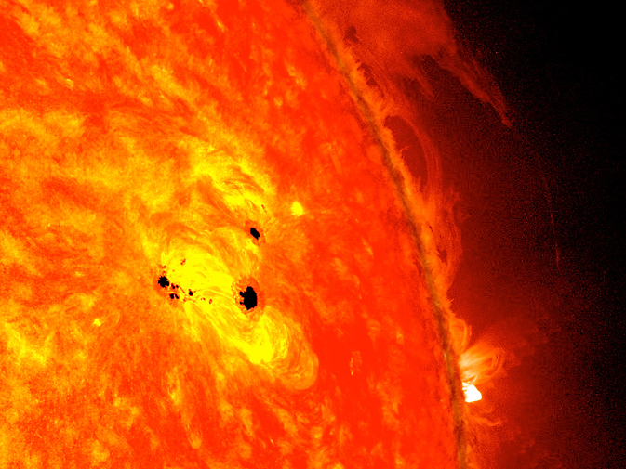
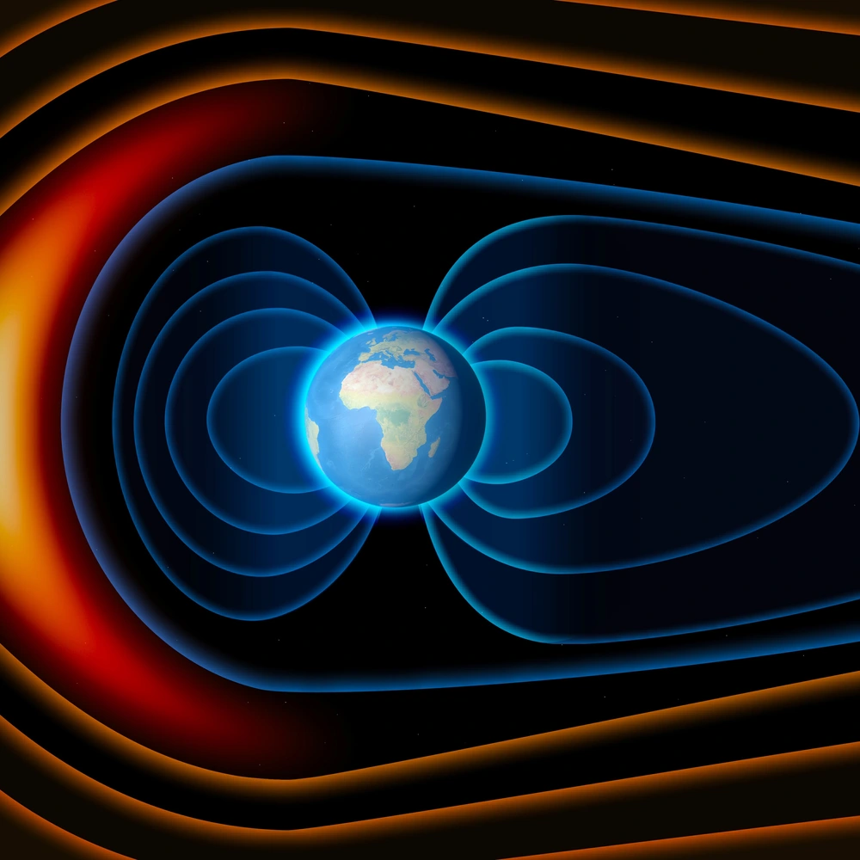
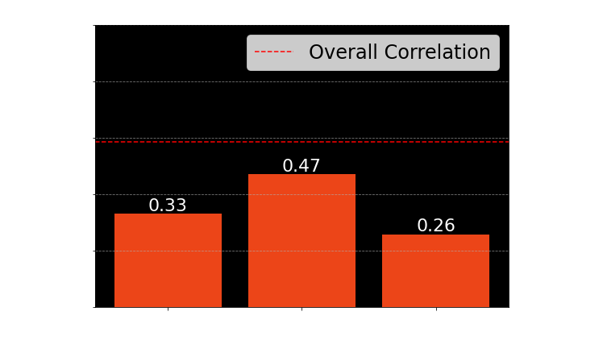
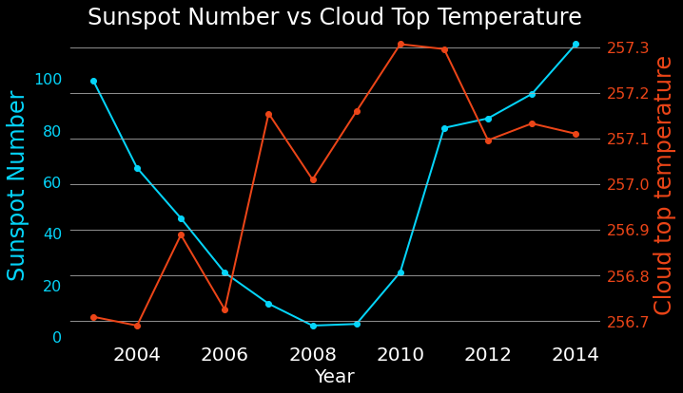
Relationship Between Solar Magnetic Activities, and Their Potential Influence on Climate Change
Shreyansh Parihar, 201684933, MSc Data Science and Analytics
Leeds University, 2022/23
INTRODUCTION
SUNSPOTS
They are areas that appear dark on the surface of the Sun. They appear dark because they are cooler than other parts of the Sun’s surface
SOLAR IRRADIANCE
It is the power per unit area received from the Sun in the form of electromagnetic radiation in the wavelength range of the measuring instrument. Solar irradiance is measured in watts per square meter in SI units.
Unveiling the Solar-Climatic Connection: Can Sunspot Activity, Solar Spectral Irradiance, and Cosmic Ray Flux Influence Climate Change? 🌞🌍🔬 Discover the intriguing relationship between solar phenomena and climate variability in this captivating study. Explore the statistical analysis of sunspot activity, SSI across different spectra, and cosmic ray flux, and delve into potential correlations with climate change data, providing valuable insights into our planet's complex relation with the sun.
AIM
Cosmic Ray Flux
It refers to the measurement of the flow or rate of cosmic rays passing through a given area in space. Cosmic rays are high-energy charged particles, such as protons, helium nuclei (alpha particles), electrons, and heavier nuclei, that originate from various astrophysical sources, including the Sun, stars, and other distant cosmic objects.
To Investigate the potential influence of solar magnetic activities (sunspot activity, SSI) and cosmic ray flux on climate change variables (cloud levels) through correlation analysis. Unraveling these intricate connections will provide valuable insights into the drivers of climate variability and contribute to a deeper understanding of our planet's climate system.
Next plan is to analyze the correlation between cosmic ray flux and cloud data to complete the climate change analysis. This will shed light on any significant associations and potential mechanisms between solar phenomena and cloud levels, further enhancing our understanding of the solar-climatic relationship.
METHODOLGY
Data Collection
Identify and gather relevant datasets for sunspot activity, solar spectral irradiance (SSI), cosmic ray flux, and climate variables
Data Analysis
Utilize statistical techniques and time series analysis to uncover significant features or anomalies in sunspot activity, SSI, and cosmic ray flux data.
Correlation Analysis:
Investigate potential correlations between sunspot activity, SSI, and cosmic ray flux.
Climate Change Analysis
Calculate correlation coefficients and perform regression analysis to quantify the strength and significance of these relationships.
Analyze how cloud variables (e.g., cloud fraction, cloud effective emissivity, cloud albedo) align with variations in sunspots and other solar activities.
Results
Compare and Analyze the results from analysis done in previous steps and present findings.
Results so far…
Literature cited
1. NASA, Sunspots and Solar Flares, [Online] [Accessed 25 June 2023]. Available from: https://spaceplace.nasa.gov/solar-activity/en/
2. SIDC, Observations, [Online] [Accessed 27 June 2023]. Available from: https://www.sidc.be/
Further information
Please email:
shreyansh.parihar@gmail.com
if you have a question or comment.
Notes:
Copyright Colin Purrington (http://colinpurrington.com/tips/academic/posterdesign).

